Slide 1

מבני נתונים
תרגול 8 – עץ ערימה, עץ בינומי וערימה בינומית

Slide 2
היום
ערמת מינימום/מקסימום
תרגילים
עץ בינומי (מצגת נפרדת)
ערימה בינומית (מצגת נפרדת)
תרגילים

Slide 3
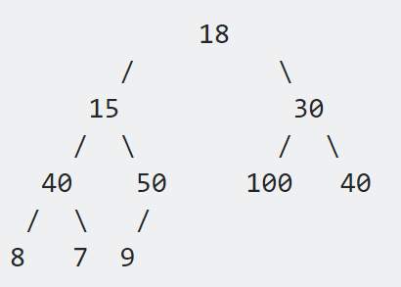
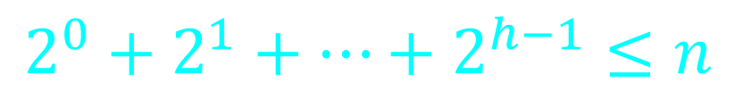
תרגולים קודמים
עץ בינארי (Binary Tree) – עץ אשר לכל קודקוד יש לכל היותר 2 בנים
עץ בינארי כמעט שלם
עץ בינארי הוא עץ בינארי כמעט שלם אם כל הרמות מלאות בעלים חוץ מהרמה האחרונה
כאשר כל העלים ברמה האחרונה הם מצד שמאל ככל היותר.
3 תנאים:
1. לכל הצמתים של גובה העץ פחות 2 יש בדיוק שני בנים. 2. אם לצומת p ברמת גובה העץ פחות 1 יש בן שמאלי אז לכל צומת שמשמאלו יש שני בנים. 3. אם לצומת p ברמה גובה העץ פחות 1 יש בן ימני אז גם יש לו בן שמאלי.
$$2^{0}+2^{1}+…+2^{h−1}≤n$$
O(h) = O(logn)
Notes:
So your next question probably is ‘what is a heap’?
I usually make up my own definitions, but I really like this one from Wiki.
Read slide.
What this means is that the value of parent node is always greater than or equal to the
value of the child node for all nodes or that the value of parent node is always less than
or equal to the value of the child node for all nodes. This means there are two types
of heaps max heaps and min heaps.
The following are binary heaps. Binary because every node has exactly two children, and
the children you cannot see are null values I haven’t drawn. On the left is a max heap
because for all nodes except the root the parent node has a value greater than or equal to its children.
Similarly on the right is min heap.
So why are we interested in heaps? Well heaps form the canonical underlying data structure for priority queues, so much so that priority queues are sometimes called heaps although this isn’t technically correct since a priority queue is an ADT meaning it can be implemented with other data structures also.

Slide 4

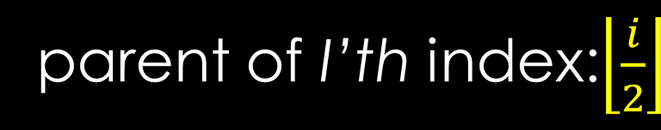
Binary Heap Representation
value
9 | 8 | 7 | 6 | 5 | 1 | 2 | 2 | 2 | 3 | 4 | 0 | 1 | 2 | 1
1 | 3 | 3 | 4 | 5 | 6 | 7 | 8 | 9 | 10 | 11 | 12 | 13 | 14 | 15
index
מבוסס אינדקס-1 (נוחות)
Let i be a node index
9
(one based) $→$ A[1] Returns the root node
8
7
Left child of i’th index: 2i
6
5
1
2
Right child of i’th index: 2i + 1
parent of I’th index:$\left\lfloor \frac{i}{2}\right\rfloor$
2
2
3
4
0
1
2
1
Notes:
One last thing before we get into how to add values to our binary heap, I promise.
We need to understand how do we represent and construct one of these binary heaps.
Well, one of the most popular ways to represent a heap is by using an array because
of the complete tree property we talked about. This is however not the only way to
represent a heap we could also use objects and pointers and recursively add and
remove nodes as needed, but right now we’re going to look at the array based construction.
On the left is the index tree to help you visualize the position of each node in the array, and
on the right is the actual tree. Remark that as you read elements in the array from left to right
it’s as though you’re pacing through the heap one layer at a time from left to right.

Slide 5
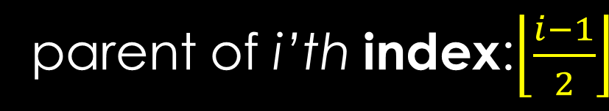
Binary Heap Representation
value
9 | 8 | 7 | 6 | 5 | 1 | 2 | 2 | 2 | 3 | 4 | 0 | 1 | 2 | 1
0 | 1 | 2 | 3 | 4 | 5 | 6 | 7 | 8 | 9 | 10 | 11 | 12 | 13 | 14
index
Let i be a node index
9
(zero based) $→$ A[0] Returns the root node
8
7
Left child of i’th index: 2i + 1
6
5
1
2
Right child of i’th index: 2i + 2
parent of i’th index:$\left\lfloor \frac{i−1}{2}\right\rfloor$
2
2
3
4
0
1
2
1
Notes:
One last thing before we get into how to add values to our binary heap, I promise.
We need to understand how do we represent and construct one of these binary heaps.
Well, one of the most popular ways to represent a heap is by using an array because
of the complete tree property we talked about. This is however not the only way to
represent a heap we could also use objects and pointers and recursively add and
remove nodes as needed, but right now we’re going to look at the array based construction.
On the left is the index tree to help you visualize the position of each node in the array, and
on the right is the actual tree. Remark that as you read elements in the array from left to right
it’s as though you’re pacing through the heap one layer at a time from left to right.

Slide 6
Binary Heap Representation
value
9 | 8 | 7 | 6 | 5 | 1 | 2 | 2 | 2 | 3 | 4 | 0 | 1 | 2 | 1
1 | 2 | 3 | 4 | 5 | 6 | 7 | 8 | 9 | 10 | 11 | 12 | 13 | 14 | 15
index
1
9
2
Index
Tree
3
8
7
4
5
6
7
6
5
1
2
8
9
10
11
12
13
14
15
2
2
3
4
0
1
2
1
Notes:
One last thing before we get into how to add values to our binary heap, I promise.
We need to understand how do we represent and construct one of these binary heaps.
Well, one of the most popular ways to represent a heap is by using an array because
of the complete tree property we talked about. This is however not the only way to
represent a heap we could also use objects and pointers and recursively add and
remove nodes as needed, but right now we’re going to look at the array based construction.
On the left is the index tree to help you visualize the position of each node in the array, and
on the right is the actual tree. Remark that as you read elements in the array from left to right
it’s as though you’re pacing through the heap one layer at a time from left to right.

Slide 7
Binary Heap Representation
value
9 | 8 | 7 | 6 | 5 | 1 | 2 | 2 | 2 | 3 | 4 | 0 | 1 | 2 | 1
1 | 2 | 3 | 4 | 5 | 6 | 7 | 8 | 9 | 10 | 11 | 12 | 13 | 14 | 15
index
1
9
2
Index
Tree
3
8
7
4
5
6
7
6
5
1
2
8
9
10
11
12
13
14
15
2
2
3
4
0
1
2
1
Notes:
One last thing before we get into how to add values to our binary heap, I promise.
We need to understand how do we represent and construct one of these binary heaps.
Well, one of the most popular ways to represent a heap is by using an array because
of the complete tree property we talked about. This is however not the only way to
represent a heap we could also use objects and pointers and recursively add and
remove nodes as needed, but right now we’re going to look at the array based construction.
On the left is the index tree to help you visualize the position of each node in the array, and
on the right is the actual tree. Remark that as you read elements in the array from left to right
it’s as though you’re pacing through the heap one layer at a time from left to right.

Slide 8
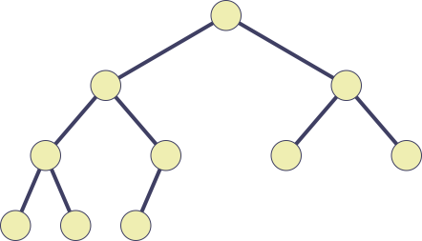
Pseudo code Implementation (1-based)
1
h
Left(i)
return 2*i end-Left
2
j
3
f
4
d
5
b
6
a
7
e
Right(i)
return 2*i+1 end-Right
i
c
g
8
9
10
1 | 2 | 3 | 4 | 5 | 6 | 7 | 8 | 9 | 10
h | j | f | d | b | a | e | i | c | g
Parent(i) (i=1,2,. . .,n)
return (i/2) end-Parent
Notes:
One last thing before we get into how to add values to our binary heap, I promise.
We need to understand how do we represent and construct one of these binary heaps.
Well, one of the most popular ways to represent a heap is by using an array because
of the complete tree property we talked about. This is however not the only way to
represent a heap we could also use objects and pointers and recursively add and
remove nodes as needed, but right now we’re going to look at the array based construction.
On the left is the index tree to help you visualize the position of each node in the array, and
on the right is the actual tree. Remark that as you read elements in the array from left to right
it’s as though you’re pacing through the heap one layer at a time from left to right.

Slide 9

Binary Heap
8
0
7
6
2
3
3
2
5
4
5
6
4
Max Heap
Min Heap
כל האיברים בעץ ניתנים להשוואה (Comparable) ושורש העץ הוא תמיד המינמלי | כל האיברים בעץ ניתנים להשוואה (Comparable) ושורש העץ הוא תמיד המקסימלי
הערך של כל קודקוד קטן או שווה מהערך של בניו - heap property | הערך של כל קודקוד גדול או שווה מהערך של בניו - heap property
עץ בינארי כמעט שלם | עץ בינארי כמעט שלם
Notes:
So your next question probably is ‘what is a heap’?
I usually make up my own definitions, but I really like this one from Wiki.
Read slide.
What this means is that the value of parent node is always greater than or equal to the
value of the child node for all nodes or that the value of parent node is always less than
or equal to the value of the child node for all nodes. This means there are two types
of heaps max heaps and min heaps.
The following are binary heaps. Binary because every node has exactly two children, and
the children you cannot see are null values I haven’t drawn. On the left is a max heap
because for all nodes except the root the parent node has a value greater than or equal to its children.
Similarly on the right is min heap.
So why are we interested in heaps? Well heaps form the canonical underlying data structure for priority queues, so much so that priority queues are sometimes called heaps although this isn’t technically correct since a priority queue is an ADT meaning it can be implemented with other data structures also.

Slide 10
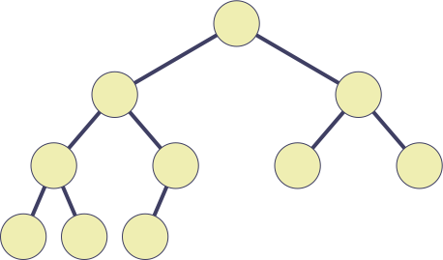
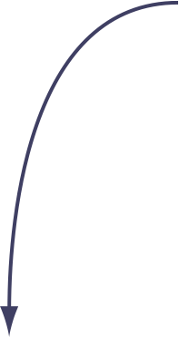

Finding the Maximum
Maximum
75
54
65
27
14
41
13
3
23
4
75
54
65
27
14
41
13
3
23
4
Notes:
So your next question probably is ‘what is a heap’?
I usually make up my own definitions, but I really like this one from Wiki.
Read slide.
What this means is that the value of parent node is always greater than or equal to the
value of the child node for all nodes or that the value of parent node is always less than
or equal to the value of the child node for all nodes. This means there are two types
of heaps max heaps and min heaps.
The following are binary heaps. Binary because every node has exactly two children, and
the children you cannot see are null values I haven’t drawn. On the left is a max heap
because for all nodes except the root the parent node has a value greater than or equal to its children.
Similarly on the right is min heap.
So why are we interested in heaps? Well heaps form the canonical underlying data structure for priority queues, so much so that priority queues are sometimes called heaps although this isn’t technically correct since a priority queue is an ADT meaning it can be implemented with other data structures also.

Slide 11
Deleting the Maximum
Maximum
75
54
65
27
14
41
13
3
23
4
75
54
65
27
14
41
13
3
23
4

Slide 12
Deleting the Maximum
Maximum
54
65
27
14
41
13
3
23
4
75
54
65
27
14
41
13
3
23
4

Slide 13
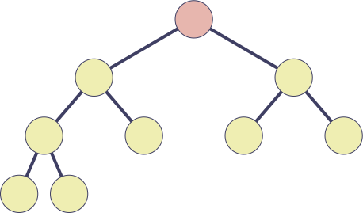

Deleting the Maximum
No longer
the maximum
4
54
65
27
14
41
13
3
23
4
54
65
27
14
41
13
3
23

Slide 14
Heapify-Down
Heapify-Down(A, i)
1 l ← left(i)
2 r ← right(i)
3 largest ← i
4 if l ≤ heap-size(A) and A[l] > A[largest]
5 then largest ← l
6 if r ≤ heap-size(A) and A[r] > A[largest]
7 then largest ← r
8 if largest > i
9 then swap A[i] ↔ A[largest]
10 Heapify-Down(A, largest)
4
54
65
27
14
41
13
3
23

Slide 15
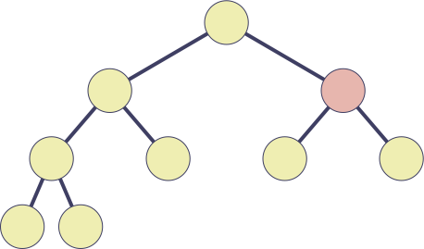
Heapify-Down
Heapify-Down(A, i)
1 l ← left(i)
2 r ← right(i)
3 largest ← i
4 if l ≤ heap-size(A) and A[l] > A[largest]
5 then largest ← l
6 if r ≤ heap-size(A) and A[r] > A[largest]
7 then largest ← r
8 if largest > i
9 then swap A[i] ↔ A[largest]
10 Heapify-Down(A, largest)
65
54
4
41
13
27
14
13
3
23

Slide 16
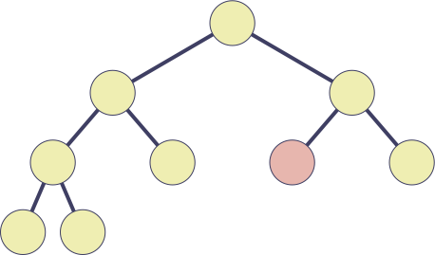
Heapify-Down
Heapify-Down(A, i)
1 l ← left(i)
2 r ← right(i)
3 largest ← i
4 if l ≤ heap-size(A) and A[l] > A[largest]
5 then largest ← l
6 if r ≤ heap-size(A) and A[r] > A[largest]
7 then largest ← r
8 if largest > i
9 then swap A[i] ↔ A[largest]
10 Heapify-Down(A, largest)
65
54
41
27
14
4
13
3
23

Slide 17
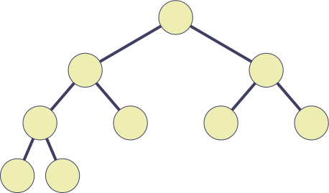

Inserting an Element
Insert(A, x)
1 heap-size(A) ← heap-size(A) + 1
2 A[heap-size(A)] ← x
3 Heapify-Up(A, heap-size(A))
65
54
41
27
14
4
13
3
23
65
54
41
27
14
4
13
3
23

Slide 18
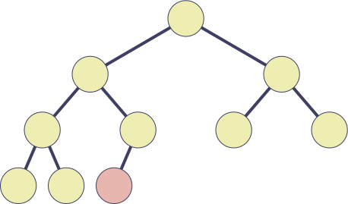

Inserting an Element
Insert(A, x)
1 heap-size(A) ← heap-size(A) + 1
2 A[heap-size(A)] ← x
3 Heapify-Up(A, heap-size(A))
65
54
41
27
14
4
13
3
23
59
65
54
41
27
14
4
13
3
23
59

Slide 19
Heapify-Up
Heapify-Up(A, i)
1 while i > 1 and A[i] > A[parent(i)]
2 do swap A[i] ↔ A[parent(i)]
3 i ← parent(i)
65
54
41
27
14
4
13
3
23
59

Slide 20
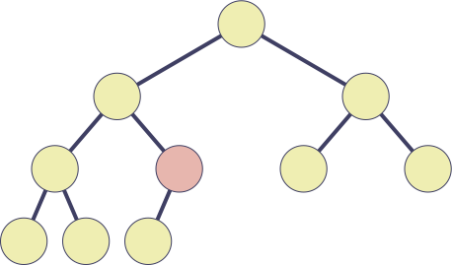
Heapify-Up
Heapify-Up(A, i)
1 while i > 1 and A[i] > A[parent(i)]
2 do swap A[i] ↔ A[parent(i)]
3 i ← parent(i)
65
54
41
27
59
4
13
3
23
14

Slide 21
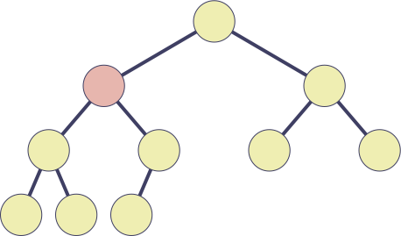
Heapify-Up
Heapify-Up(A, i)
1 while i > 1 and A[i] > A[parent(i)]
2 do swap A[i] ↔ A[parent(i)]
3 i ← parent(i)
65
59
41
27
54
4
13
3
23
14

Slide 22
Deleting an Element
Delete(A, i)
1 A[i] ← A[heap-size(A)]
2 heap-size(A) ← heap-size(A) – 1
3 if i > 1 and A[i] > A[parent(i)]
4 then Heapify-Up(A, i)
5 else Heapify-Down(A, i)
65
59
41
24
54
4
13
3
23
14
65
59
41
24
54
4
13
3
23
14

Slide 23
Deleting an Element
Delete(A, i)
1 A[i] ← A[heap-size(A)]
2 heap-size(A) ← heap-size(A) – 1
3 if i > 1 and A[i] > A[parent(i)]
4 then Heapify-Up(A, i)
5 else Heapify-Down(A, i)
65
41
24
54
4
13
3
23
14
65
41
24
54
4
13
3
23
14

Slide 24
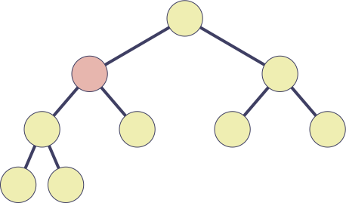

Deleting an Element
Delete(A, i)
1 A[i] ← A[heap-size(A)]
2 heap-size(A) ← heap-size(A) – 1
3 if i > 1 and A[i] > A[parent(i)]
4 then Heapify-Up(A, i)
5 else Heapify-Down(A, i)
65
14
41
24
54
4
13
3
23
65
14
41
24
54
4
13
3
23

Slide 25
Deleting an Element
Delete(A, i)
1 A[i] ← A[heap-size(A)]
2 heap-size(A) ← heap-size(A) – 1
3 if i > 1 and A[i] > A[parent(i)]
4 then Heapify-Up(A, i)
5 else Heapify-Down(A, i)
65
54
41
24
14
4
13
3
23
65
54
41
24
14
4
13
3
23

Slide 26
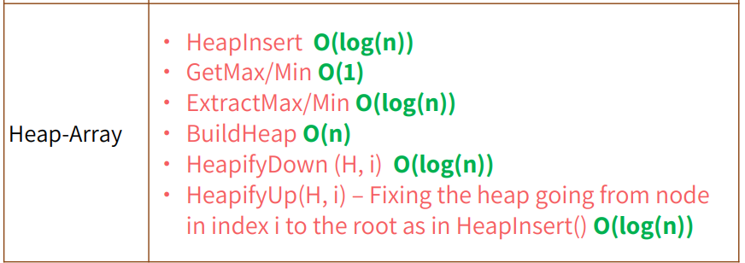
Cost of Heap Operations

Slide 27
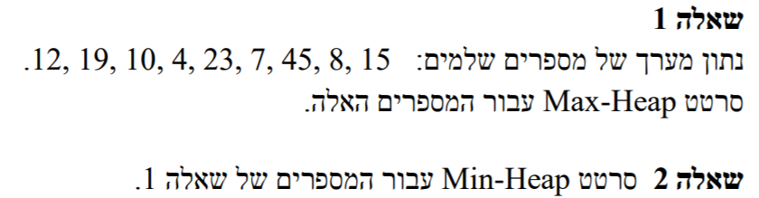
החלק האהוב עליכם - תרגילים

Slide 28
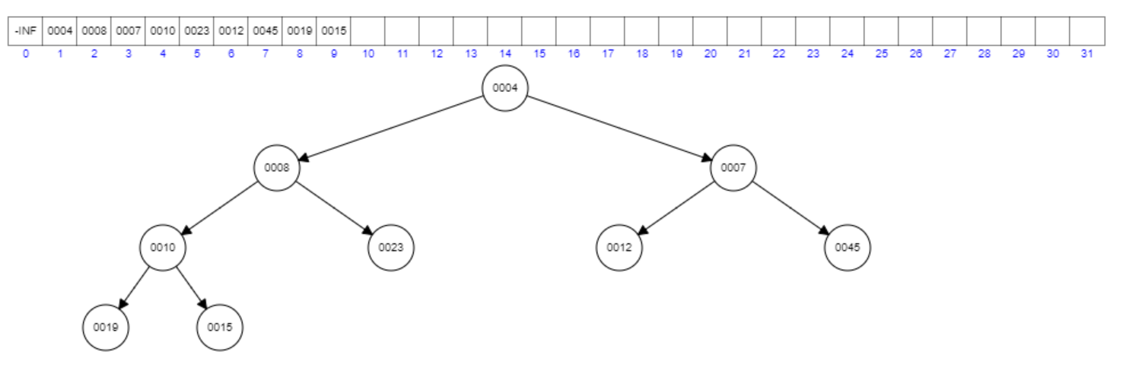
פתרון תרגיל 2
אתר לויזואליזצייה של Min-Heap

Slide 29
בהינתן ערימת מקסימום H עם n איברים,
מהי סיבוכיות הזמן למציאת 3 האיברים הגדולים בH?

Slide 30

פתרון:
לוקח $O\left(1\right)$ למצוא את שלושת האיברים המקסימליים בH. האיברים הם:
השורש
הבן המקסימלי של השורש $y$
המקסימלי מבין הבן השני של השורש או אחד הבנים של $y$

Slide 31
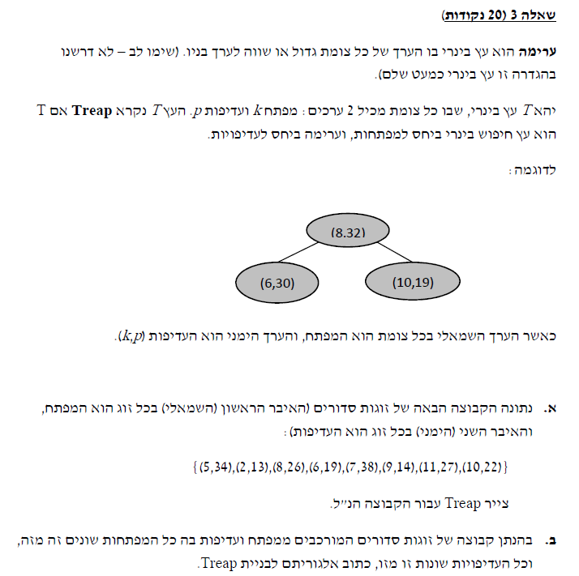
(2,13), (9,14), (6,19), (10,22),
(8,26), (11,27), (5,34), (7,38)
(7,38)
(5,34)
(11,27)
(2,13)
(6,19)
(8,26)
(10,22)
(9,14)
Sort the nodes based on p.
Start picking the node with the largest p
and decide whether it should go to the left subtree
or right subtree based on k.
https://leetcode.com/discuss/interview-question/363945/google-treap

Slide 32
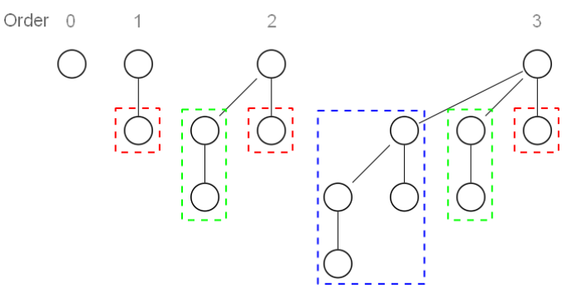

עץ בינומי
עץ בינומי מדרגה 0 מכיל צומת יחיד.
עץ בינומי מדרגהk הוא:
בעל שורש מדרגהk
ילדיו הינם עצים בינומיים מדרגות $k−1, k−2, …, 0$

Slide 33

תכונות עיקריות של עץ בינומי
לעץ בינומי מסדר $k$ יש $2^{k}$ קודקודים.
עץ בינומי אינו עץ בינארי.
בהינתן דרגת השורש $k$, היא הגדולה בעץ וכל קודקוד אחר דרגתו קטנה ממש מ-$k$.
ישנם $\left({n \atop i}\right)$ צמתים בגובה $i$.

Slide 34
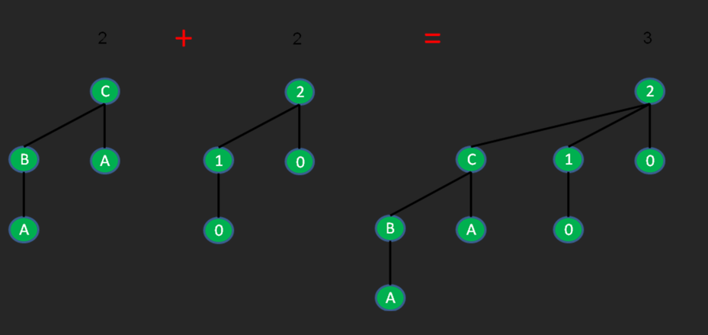

חיבור/איחוד עצים בינומיים
לוקחים את השורש של אחד מהעצים, והוא נעשה הבן ה-$k$ של השורש השני. לכן מספר הצמתים בעץ בינומי בסדר גודל $k+1$ $\left(2^{k+1}\right)$הוא כפול מספר הצמתים בעץ בינומי בסדר גודל $k$, כלומר $2k$ צמתים. זמן ריצה של חיבור הוא $O(1)$.

Slide 35
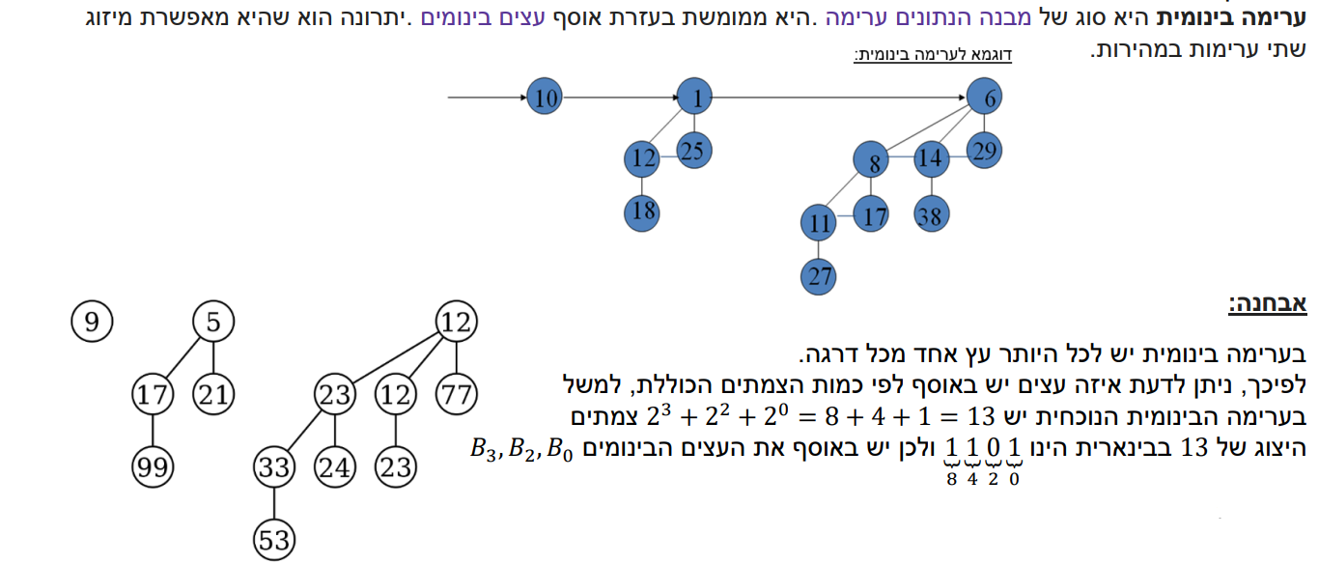
ערימה בינומית

Slide 36


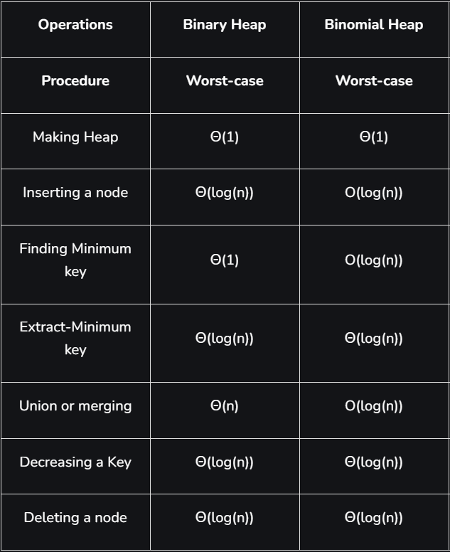



פעולות על ערימות בינומיות וזמני ריצה

Slide 37
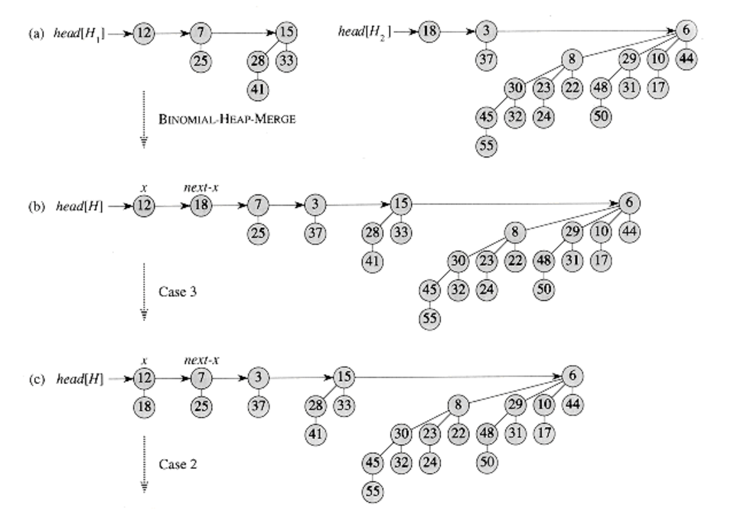
דוגמה טובה לאיחוד ערימות בינומית
זה לא משנה את מי נאחד מבין 12,7,3 העיקר שנאחד נכון (אלא אם כן נאמר אחרת בהרצאות)

Slide 38
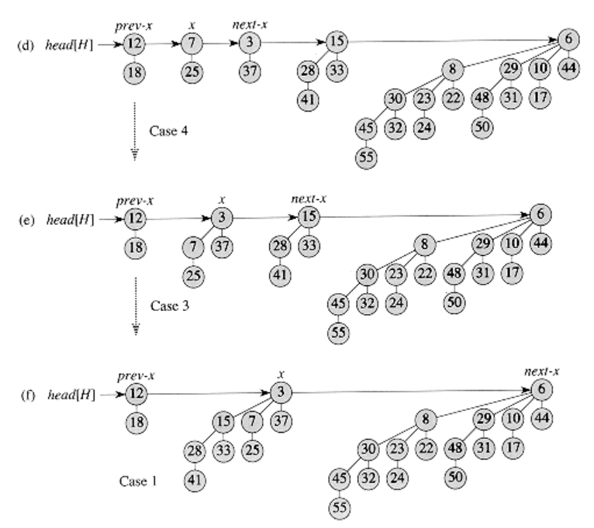
עוד לא סיימנו ☺

Slide 39
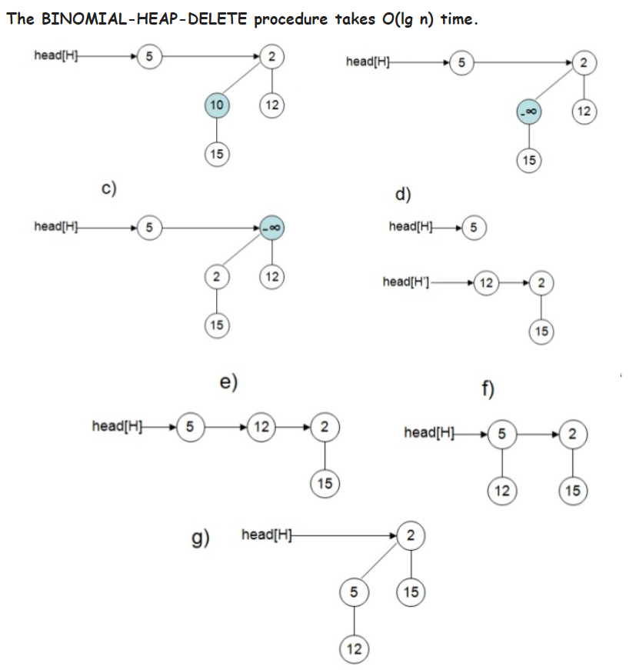
מחיקת איבר מערימה בינומית

Slide 40
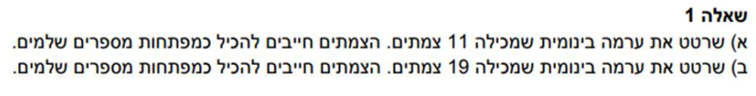
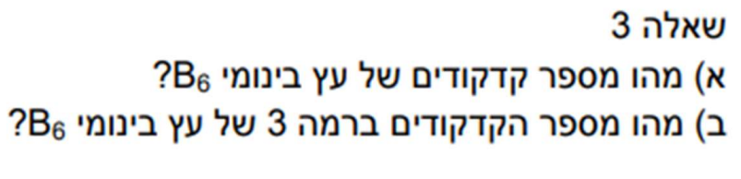
תרגילים

Slide 41
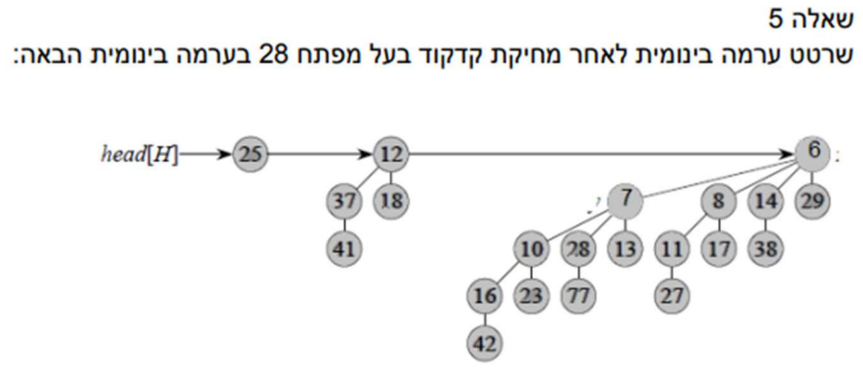
עוד תרגיל אחרון

Slide 42
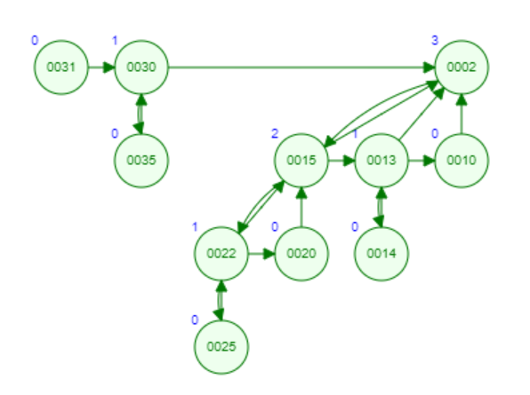
פתרונות
1.א)

Slide 43
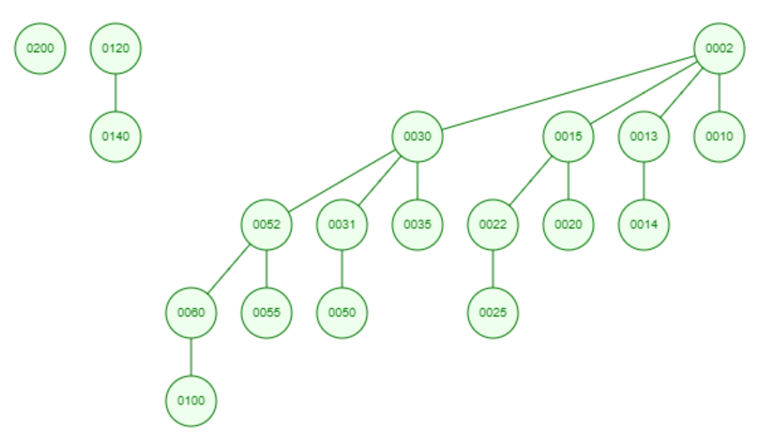
המשך פתרונות
1.ב)

Slide 44

המשך פתרונות
3.א) כפי שציינו, בעץ בינומי מדרגה $k$ יש $2^{k}$ קודקודים, לכן ל-$B_{6}$ יש $2^{6}=64$ קודקודים.
3.ב) גם זאת ציינו שלרמה ה-$i$ יש $\left({n \atop i}\right)$ קודקודים, לכן ברמה 3 ל-$B_{6}$ יש $\left({6 \atop 3}\right)=\frac{6!}{3!3!}=\frac{4∗5∗6}{1∗2∗3} =20$ קודקודים.

